Slide 1
Array’s

Slide 2
Arrays
Array : is a collection of a fixed number of homogeneous elements
Each element of an array can be accessed and modified individually
Declaration of an array
The name (identifier) of an array is user defined, specified with the size(number of elements) in the [ ] brackets
Examples:
int counter[10]; // counter is an array of 10 integers
char name[20]; // name is an array of 20 characters

Slide 3
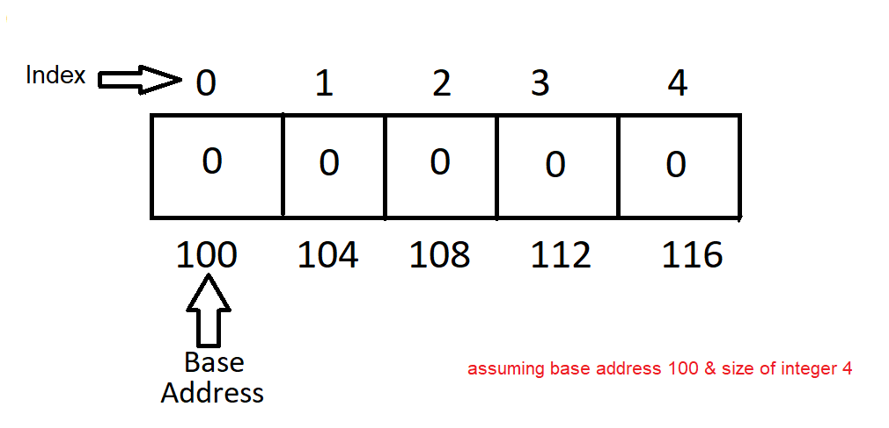
Declaration of Array
int value[5]={0};
TYPE
SIZE
(number of elements)
NAME
(user defined)

Slide 4
Arrays
The size of an array should be constant and provided at compile time
But since the C99 standard, the size of an array can be provided at run time :
int n; n = …. // some computation or user input float table[n];
Once defined, the size cannot be changed
Gilles Carpentier ISEP
4

Slide 5
One-dimensional Array’s

Slide 6
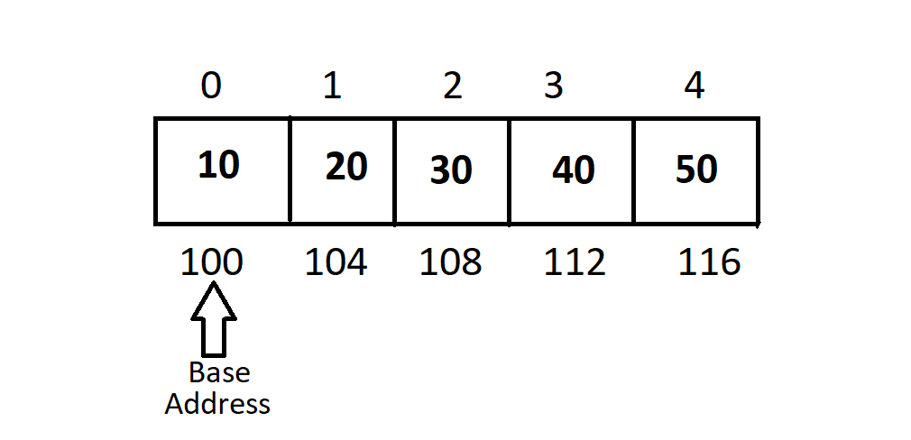
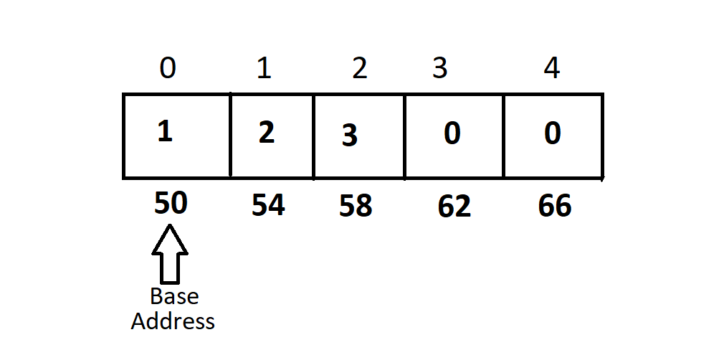
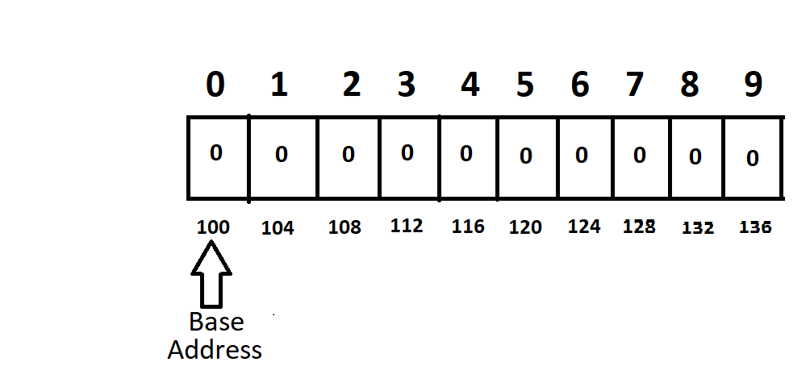
Initializing 1D int Array
int abc[5]={10,20,30,40,50};
int xyz[ ]={10,20,30,40,50};
int counter[5]={1,2,3};
int values[10]={0};

Slide 7
Initializing Arrays
You may initialize the array when you declare it
Uninitialized array may contain garbage(unknown) values
If less values than the size of the array are specified, the remaining elements will be initialized with a null values (zero)
When initialized size will be auto calculated (brackets can be kept empty)
Gilles Carpentier ISEP
7

Slide 8
Accessing Array elements
elements are identified by their relative position in an array
the index begins with 0 & last index is the size of the array – 1
each element of an array can be accessed and modified individually
Example:
count[3] = 23; // assigns the value 23 to 4th element of the array count
count[3] += 10; // adds 10 in the element count[3]

Slide 9
1D int array code Example 1
Program to scan & display array of 5 int :
#include<stdio.h>
int main( )
{
int i=0,arr[5]={0};
printf(“enter 5 numbers : “);
for(i=0; i<5 ; i++)
scanf(“%d”,&arr[i]);
printf(“\nArray elements are : “);
for(i=0; i<5 ; i++)
printf(“%d\t“,arr[i]);
return 0;
}

Slide 10
1D int array code Example 2
Program to scan array & display addition of elements :
#include<stdio.h>
int main( )
{
int i=0,xyz[5]={0},r=0;
printf(“enter 5 numbers : “);
for(i=0; i<5 ; i++)
scanf(“%d”,&xyz[i]);
for(i=0; i<5 ; i++)
r += xyz[i] ;
printf(“\n addition of array elements : %d“,r);
return 0;
}

Slide 11
1D int array code Example 3
Program to scan array & find largest number in array :
#include<stdio.h>
int main(void)
{
int j =0 ,arr[5]={0}, largest_no=0;
printf(“enter 5 numbers : “);
for(j=0; j<5 ; j++)
scanf(“%d”,&arr[j]);
largest_no = arr[0];
for(j=0; j<5 ; j++)
{
if(largest_no < arr[j] )
largest_no=arr[j];
}
printf(“\n largest number of array : %d“, largest_no);
return 0;
}

Slide 12
Some points to remember…
Array cannot be assigned to another array !
Example :
int arr[3] = {1,2,3}, xyz[3] = {10,20,30};
arr = xyz; // forbidden by the compiler
Array’s do not have boundary check !!!

Slide 13
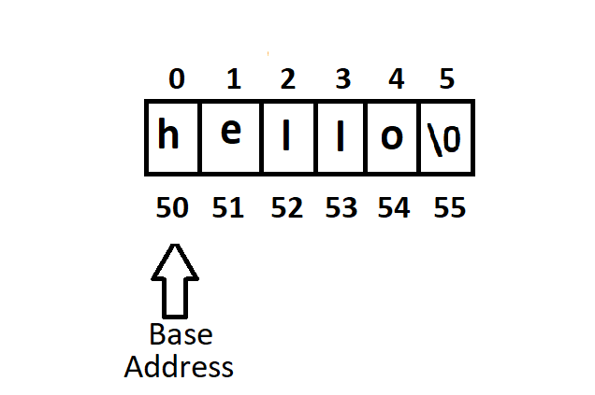
Initializing 1D char Array
(string)
char str[6] = “hello”;
char str[ ] = “hello”;
It’s a NULL (‘\0’) terminated character array (string), ASCII value of ‘\0’ is 0

Slide 14
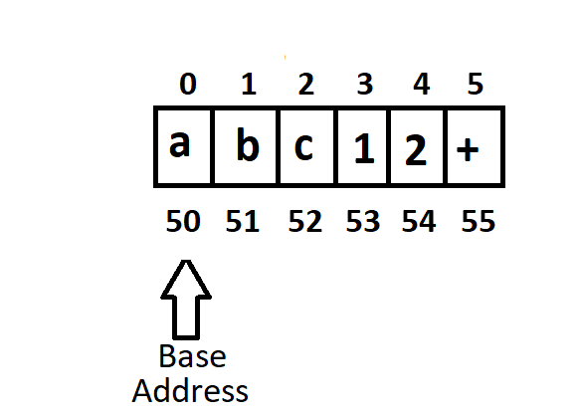
Initializing 1D char Array
(string)
char abc[6] = { ‘a’,’b’,’c’,’1’,’2’,’+’};
char abc[ ] = { ‘a’,’b’,’c’,’1’,’2’,’+’};
NULL (‘\0’) is not added, if not added explicitly

Slide 15
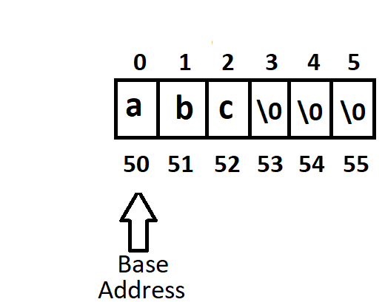
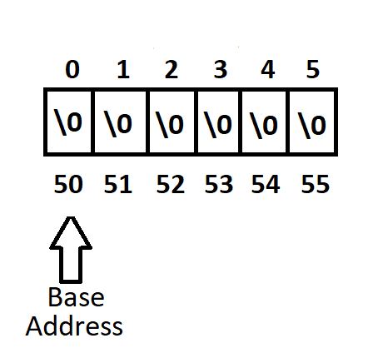
Initializing 1D char Array
(string)
char xyz[6] = { ‘a’,’b’,’c’};
char xyz[6] = {‘\0’};
Partial Initialization : uninitialized elements are initialized to NULL

Slide 16
1D char array code Example 1
Program to scan & display string :
#include<stdio.h>
int main( )
{
char str[10]={0},abc[10]={0};
printf(“enter a string : “);
scanf(“%s”,str);
printf(“\n you entered : %s“,str);
printf(“enter a string : “);
gets(str);
printf(“\n you entered : “);
puts(str);
return 0;
}
gets can scan spaces as a part of string

Slide 17
1D char array code Example 2
Program to scan two strings & concatenate 2nd string at the end of 1st string :
#include<stdio.h>
int main( )
{
int i=0,j=0;
char str[10]={0}, abc[5]={0};
printf(“enter two strings : “);
scanf(“%s%s”,str,abc);
for(i=0 ; str[i]!=0 ; i++);
for( j=0 ; abc[j]!=0 ; j++,i++)
str[ i ]=abc[ j ];
printf(“\n concatenated string : %s“,str);
return 0;
}

Slide 18
Two-dimensional Array’s

Slide 19
Two-dimensional Array’s
2D Array : is an array of array’s, organized as matrices which can be represented as the collection of rows and columns
Each element of an array can be accessed and modified individually
Declaration of an array
The name (identifier) of an array is user defined, specified with the size(number of rows & coulmns) in the [ ] [ ] brackets
Examples:
int counter[3][5]; // counter is an array of 3 rows each of 5 columns
char name[5][10]; // name is an array of 5 rows each of 10 columns

Slide 20
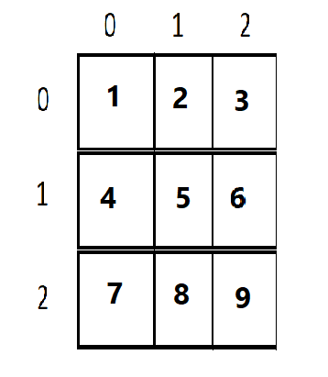
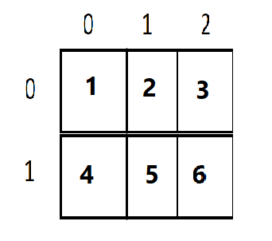
Initializing 2D int Array
int arr[3][3] = {1,2,3,4,5,6,7,8,9};
int arr[ ][3] = {1,2,3,4,5,6};

Slide 21
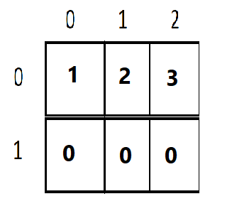
Initializing 2D int Array
int arr[3][3] = { {1,2,3},{4,5,6},{7,8,9} };
int arr[2][3] = {1,2,3};

Slide 22
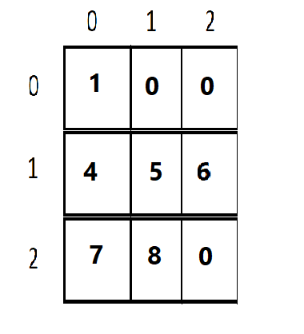
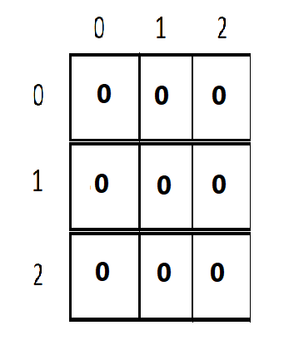
Initializing 2D int Array
int arr[3][3] = { {1},{4,5,6},{7,8} };
int arr[3][3] = {0};

Slide 23
2D int array code Example 1
Program to scan & display array of 2 × 3 :
#include<stdio.h>
int main( )
{
int arr[2][3]={0},i=0,j=0;
printf(“enter 6 numbers : );
for(i=0; i<2 ; i++)
{
for(j=0; j<3 ; j++)
scanf(“%d”,&arr[ i ][ j ]);
}
for(i=0; i<2 ; i++)
{
for(j=0; j<3 ; j++)
printf(“%d\t“,arr[ i][ j ]);
printf(“\n“);
}
return 0;
}

Slide 24
2D int array code Example 2
Program to scan & find transpose of 3 × 3 array :
#include<stdio.h>
int main( )
{
int arr[3][3]={0},abc[3][3]={0},i=0,j=0;
printf(“enter 9 numbers : “);
for(i=0; i<3 ; i++)
{
for(j=0; j<3 ; j++)
scanf(“%d”,&arr[ i ][ j ]);
}
for(i=0; i<3 ; i++)
{
for(j=0; j<3 ; j++)
abc[ j ][ i ] = arr[ i ][ j ];
}
for(i=0; i<3 ; i++)
{
for(j=0; j<3 ; j++)
printf(“\t%d“,abc[ i ][ j ]);
printf(“\n“);
}
return 0;
}

Slide 25
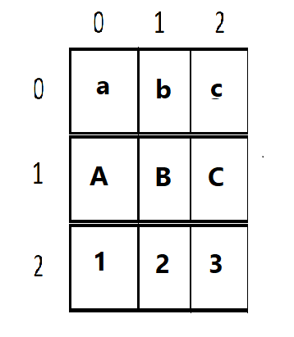
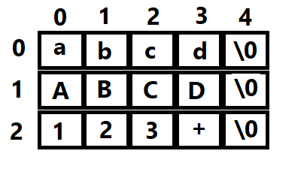
Initializing 2D char Array
char str[3][5] = {“abcd”,”ABCD”,”123+”};
char abc[3][3] = {‘a’,’b’,’c’,’A’,’B’,’C’,’1’,’2’,’3’};

Slide 26
Initializing 2D char Array
char abc[ ][3] = {‘a’,’b’,’c’,’A’,’B’,’C’,’1’,’2’,’3’};
char abc[3][3] = { {‘a’,’b’,’c’},{‘A’,’B’,’C’},{‘1’,’2’,’3’} };

Slide 27
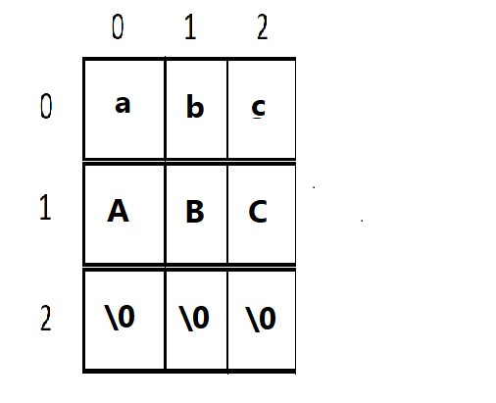
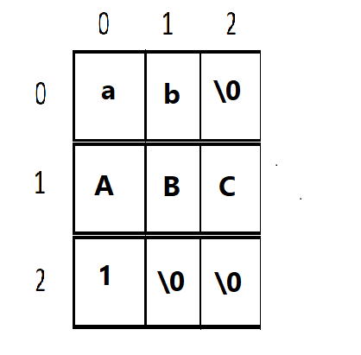
Initializing 2D char Array
char abc[3][3] = {‘a’,’b’,’c’,’A’,’B’,’C’};
char abc[3][3] = { {‘a’,’b’},{‘A’,’B’,’C’},{‘1’} };

Slide 28
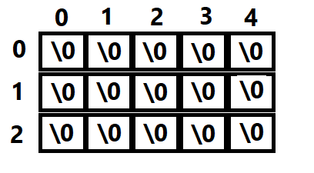
Initializing 2D char Array
char str[3][5] = {‘\0’};

Slide 29
2D character array code Example 1
Program to scan & display array of 3 × 5 :
#include<stdio.h>
int main( )
{
char str[3][5] = {0};
int i=0;
printf(“enter 3 strings : “);
for(i=0; i<3 ; i++)
scanf(“%s”,str[ i ]);
for(i=0; i<3 ; i++)
printf(“%s\n“,str[ i ]);
return 0;
}

Slide 30
2D character array code Example 2
Program to scan array of 3 × 5 & convert all lowercase characters into uppercase:
#include<stdio.h>
int main( )
{
char str[3][5]={0};
int i=0,j=0;
printf(“enter 3 strings : “);
for(i=0; i<3 ; i++)
scanf(“%s”,str[ i ]);
for(i=0; i<3 ; i++)
{
for(j=0 ; str[ i ] [ j ] != 0 ; j++)
str[ i ][ j ] - = 32;
}
for(i=0; i<3 ; i++)
printf(“%s\n“,str[ i ]);
return 0;
}

